Slide 1
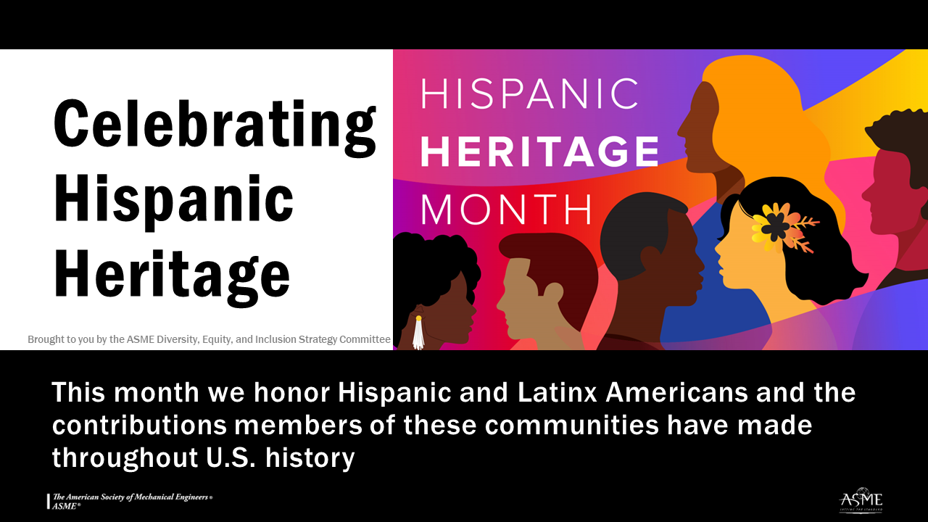
Notes:
National Hispanic Heritage Month begins on September 15 and runs until October 15. Each year, during this period we celebrate the contributions, heritage and culture of Americans whose ancestors came from Mexico, the Caribbean, Central and South America, and Spain. According to the 2020 Census, more than 18% of the U.S. population is of Hispanic or Latino origin. The U.S. Hispanic/Latinx population is extremely diverse, encompassing people of different races, ancestries, and national origins.
First celebrated in 1968 as Hispanic Heritage Week under President Lyndon Johnson, the Hispanic Heritage observance was expanded by President Ronald Reagan in 1988 to cover a 30-day period. September 15 was chosen as the starting point for the celebration because it is the anniversary of independence of five Latin American countries: Costa Rica, El Salvador, Guatemala, Honduras and Nicaragua. Mexico, Chile and Belize also celebrate their independence days in September.
ASME has a long commitment to supporting Hispanic engineers and is a proud partner of the Society of Hispanic Professional Engineers (SHPE). ASME and SHPE offer reciprocal membership benefits, and a joint scholarship to encourage the next generation of engineers. Both organizations understand that pursuing diversity in engineering and STEM fields ultimately leads to more innovation. We are stronger together.
For more information and resources:
Library of Congress Hispanic Heritage Month info: https://www.hispanicheritagemonth.gov/
SHPE website: https://shpe.org/
U.S. Census explanation of ethnicity question: https://www.census.gov/acs/www/about/why-we-ask-each-question/ethnicity/
Hispanic inventors and innovators: https://www.uspto.gov/learning-and-resources/journeys-innovation/hispanic-innovators

